Slide 1

Navigation Deck for Performance Evaluation
1

Slide 2


Goal Management module in Tata Play Universe is designed to facilitate:
Setting performance goals and milestones for the financial year
Tracking and updating progress throughout the year
Submitting goals for managerial and reviewer approval
Goal Management
The Goal Management module is used for the purpose of Goal setting and monitoring the progress of these goals throughout the Financial year.
Employees have to fill GOALS & MILESTONES for the entire FY, along with start and end dates, weightages and submit to their manager/reviewer for approval.
Progress of Goal can be updated/modified/added any time during the financial year using this Module.
Performance Management
Employees under quarterly assessments will have 4 evaluation documents for the FY while employees with half yearly assessment will have 2 documents.
Once goals are approved in Goal Management Module, they will be populated in "performance document" which are created at the beginning of each Quarterly/Half yearly cycle.
All Active Goals in the Goal Management module at the time of creating Performance Document would be populated into the Performance documents. These include Goals with Zero Weightage.

Slide 3
Performance Management: Highlights
'Self Rating' at employee assessment stage on KRA's against the 5 point rating scale.
Employees are required to update their achievements for each goal & milestone in "employee comments" section, relevant for the performance period (quarterly/half year as applicable).
Post Manager's evaluation, the performance document would be reviewed by the Manager's Manager (Reviewer) before it is reviewed by the Region's Head/Chief of Function.
The finalized ratings would be made visible to employees as soon as the review cycle is closed.
NOTE: While the GOAL Management Module will give an overview of Goals for the year, the PERFORMANCE DOCUMENTS (Quarterly and Half yearly) will be treated as final for the purpose of ratings.
Changes to goals before appraisal process
If a goal needs to be added or modified it can be done in the performance document itself, changes to the weightages should be done in the performance document itself

Slide 4
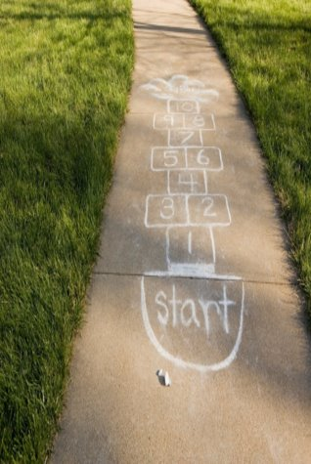
Process
Employee Related Tasks
Manager Related Tasks
Reviewer Related Tasks

Slide 5

Employee Related Tasks

Slide 6
Employee Self Evaluation – Process Workflow
Login to the system and go to:
Me > Career and Performance > Performance
Open the Performance evaluation document
Update Goals (if needed):
Click on ‘Update your goals’ to access the Goals Center, make changes, and submit.
Rate Your Goals:
  Scroll to the Goals section
  Provide ratings and comments
  Click ‘Save and Next’ for each goal
  In the Summary section, click ‘Calculate’, add comments, and ‘Save and Close’
Final Submission:
  Go to the ‘Overall Summary’ section
  Provide final rating and comments
  Click ‘Submit’ to send it to your manager

Slide 7
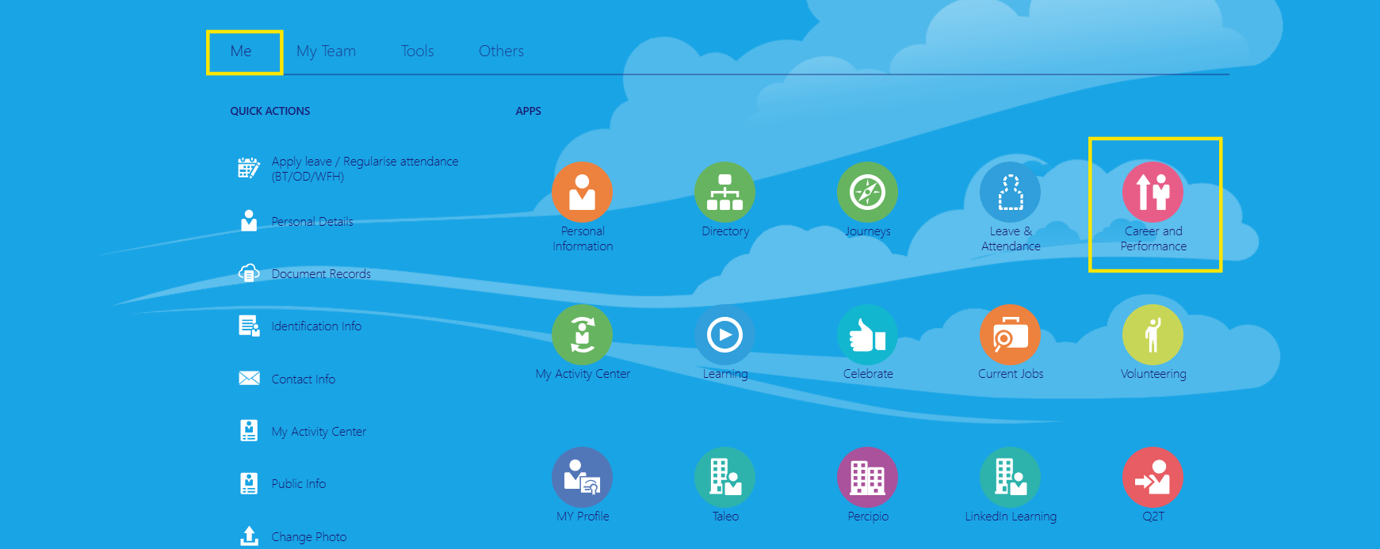
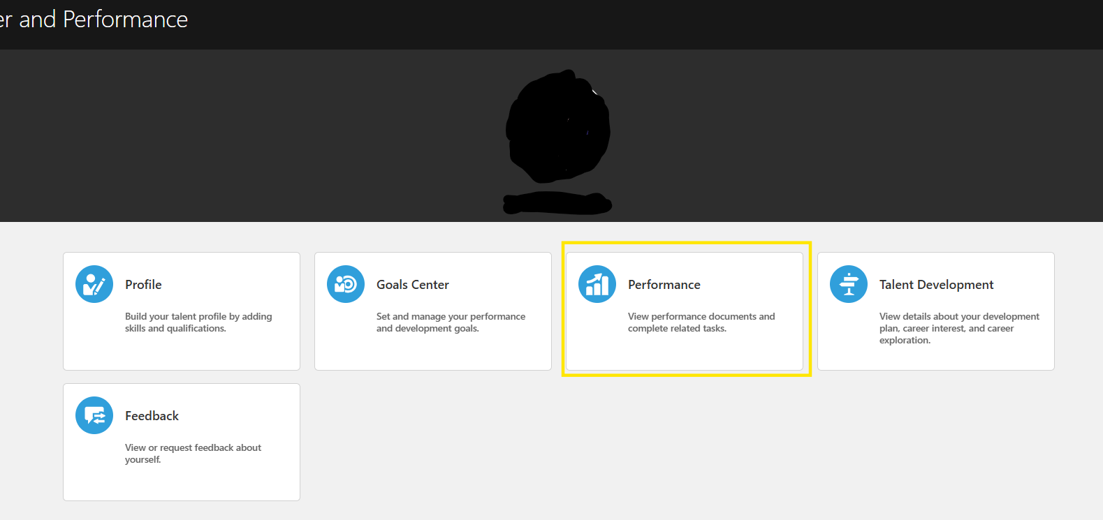
Login into the system and go to Me > Career and Performance > Performance
Employee Self Evaluation

Slide 8
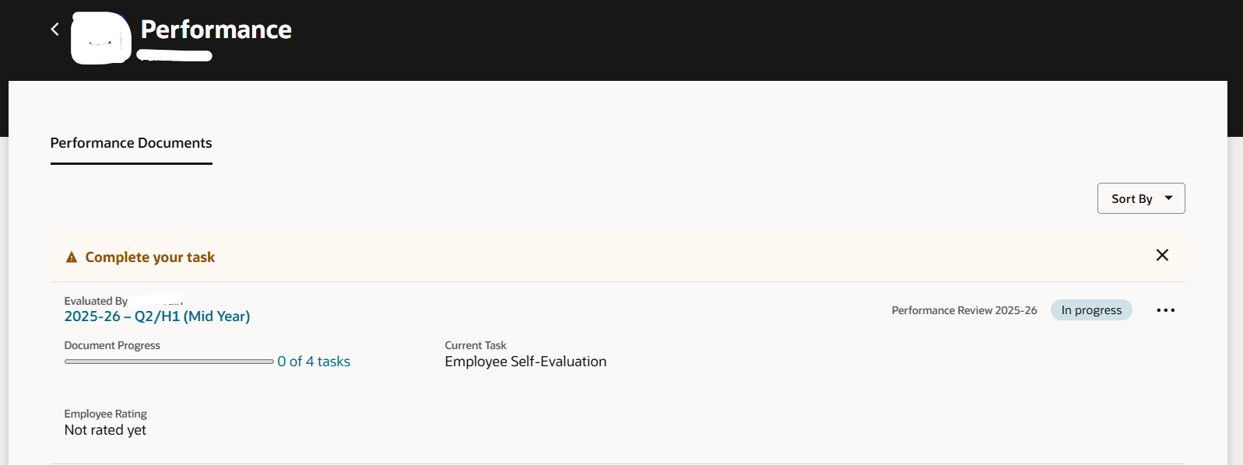
Click on the second quarter evaluation document.
Evaluation of Performance Document

Slide 9
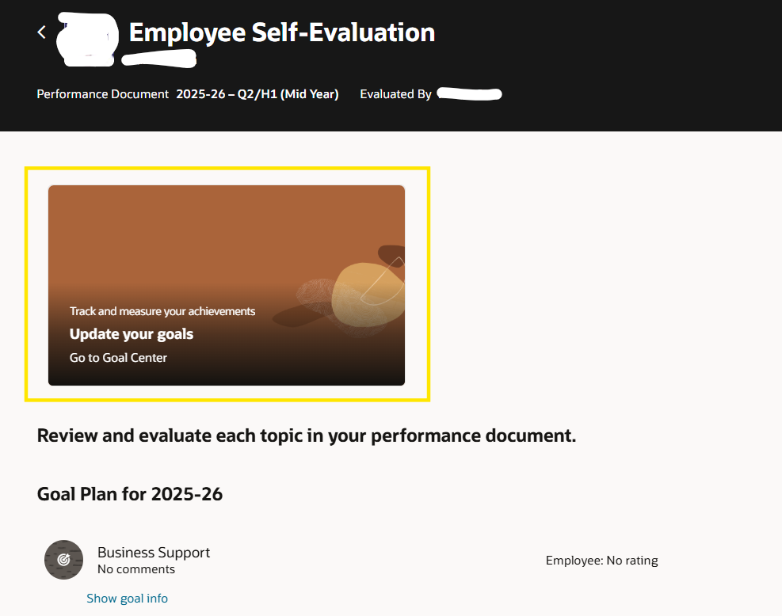
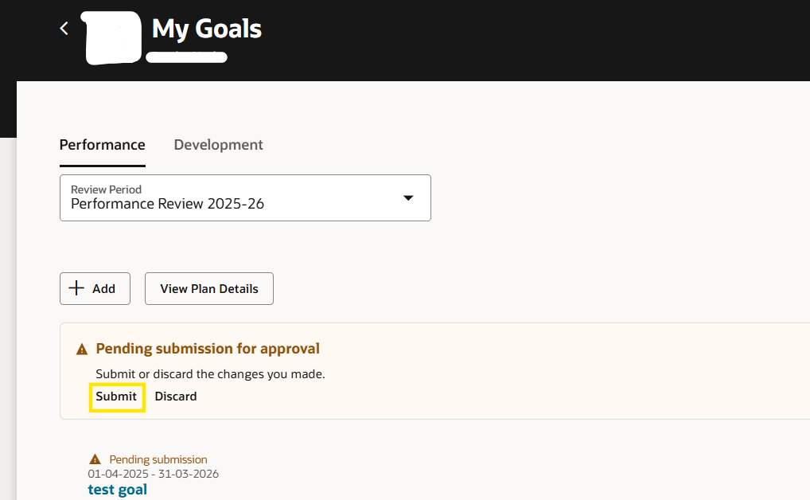
If you need to make some changes in the goals before evaluation click on the ‘Update your goals’ card to go to the ‘Goals Center’.
After making the goal changes submit them, the new goals will be auto updated in the performance document.
Evaluation of Performance Document

Slide 10
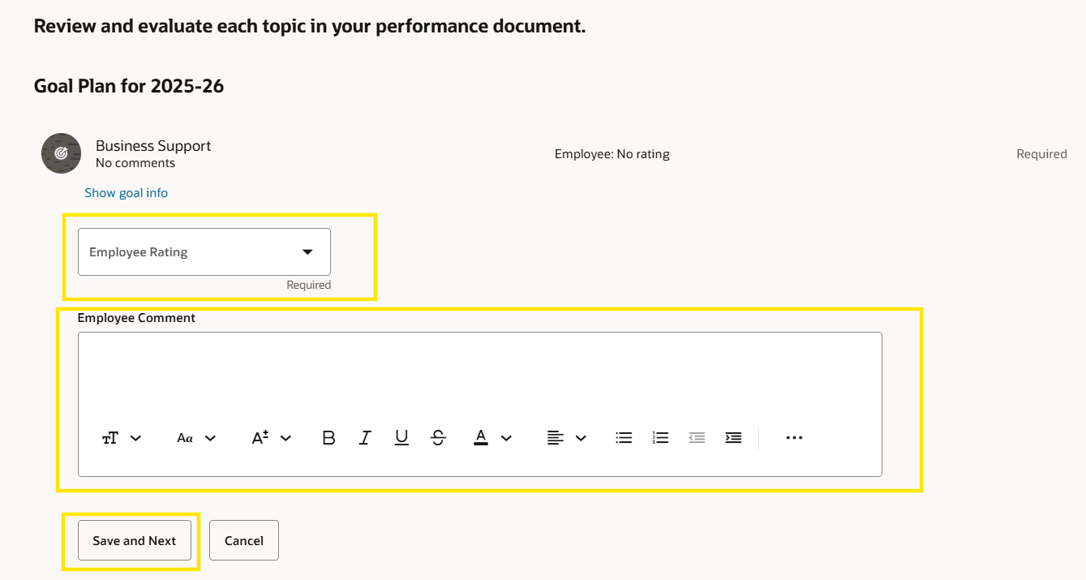
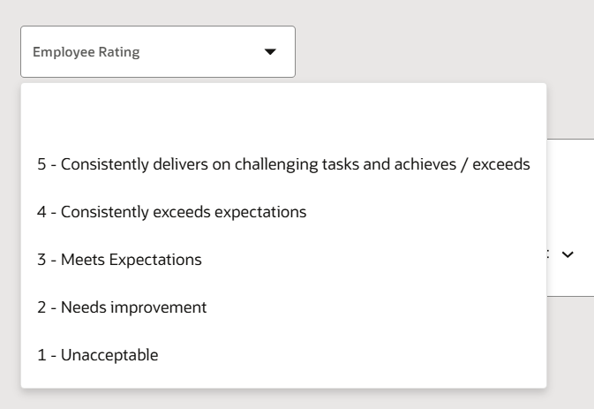
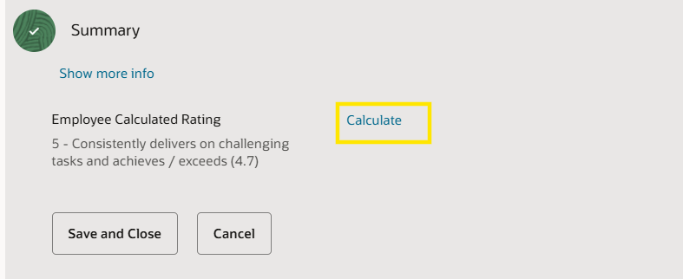
Scroll down to the Goals section and provide rating and comments and click ‘Save and Next’
Repeat the same step for each of the goals.
In the Summary section of goals click ‘Calculate’ to give calculated rating, the provide comment and click ‘Save and Close’.
Evaluation of Performance Document

Slide 11
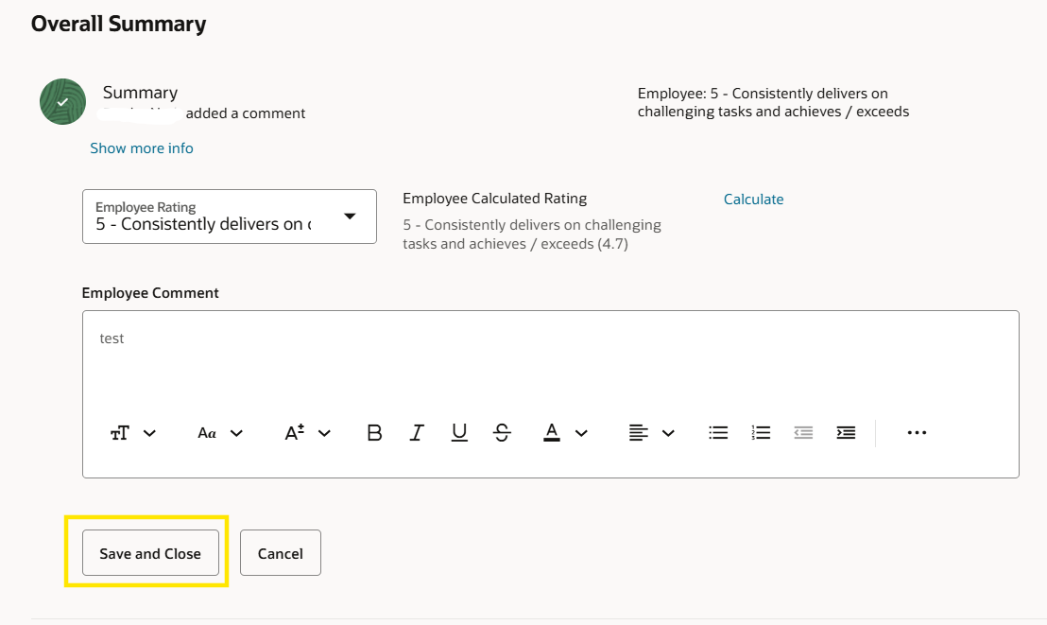
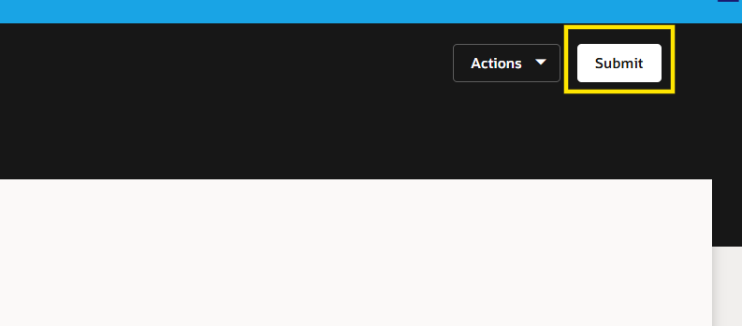
Scroll down to the ‘Overall Summary’ section.
Provide the final rating and comments and click ‘Save and Close’
After providing all the ratings and comments click on ‘Submit’
Evaluation of Performance Document

Slide 12
Manager Related Tasks

Slide 13
Manager Evaluation : Process Overview
On completion of self-evaluation by your team member :
1. Access the Document:
Via notification
Or go to: My Team > Performance > Q2/H1 Document
2. : Evaluate Goals:
Rate each goal and add comments
Use ‘Calculate’ in the summary section
Click ‘Save and Close’
3. Submit for Review:
Provide overall rating and comments
Click ‘Submit’ twice to send it for reviewer approval

Slide 14
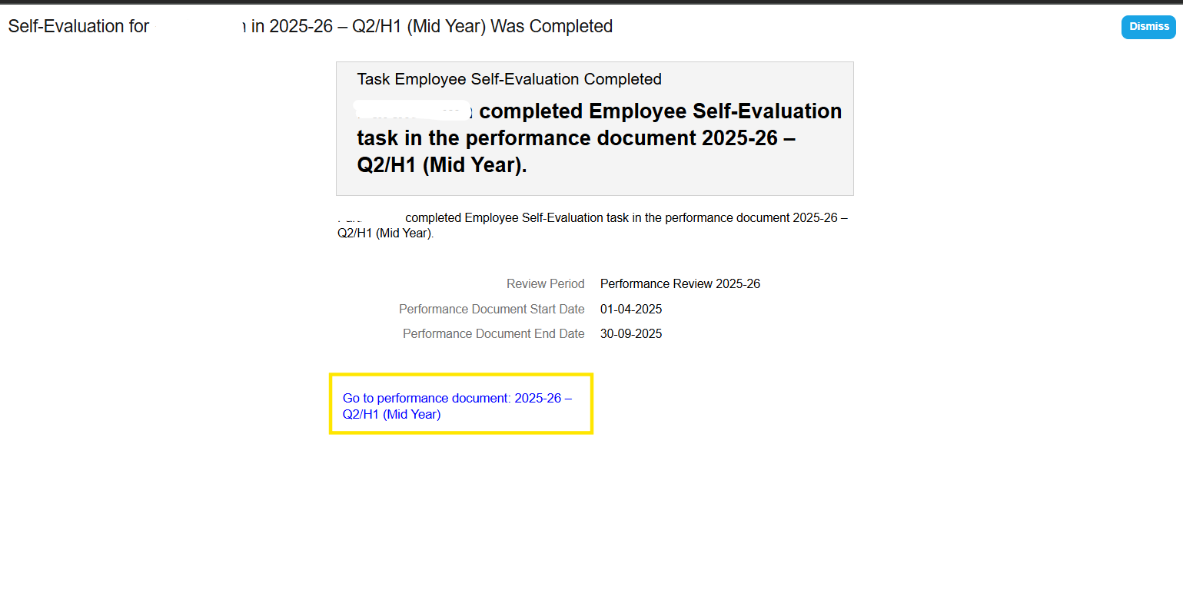
Once the employee submits the document notification will trigger to the line manager.
Manager Evaluation

Slide 15
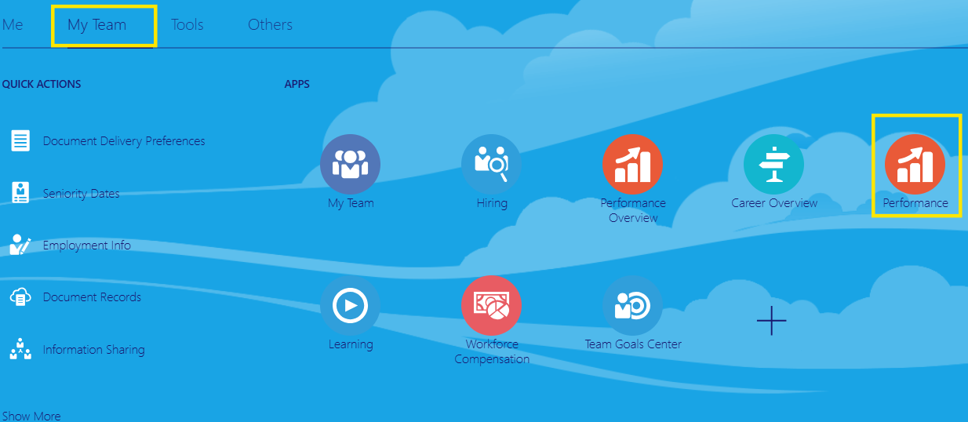
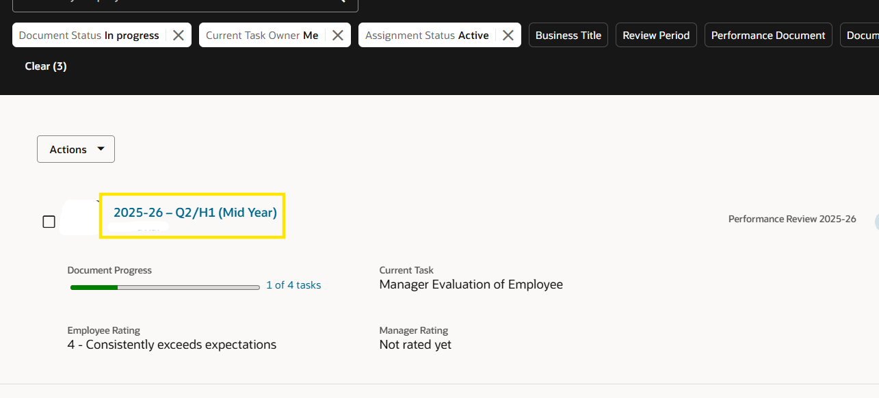
Manager will click on the link in the notification to go to the document or through below path
My team > Performance > Click on the Q2 / H1 (Mid Year) Document name to open it
Manager Evaluation – Performance Document

Slide 16
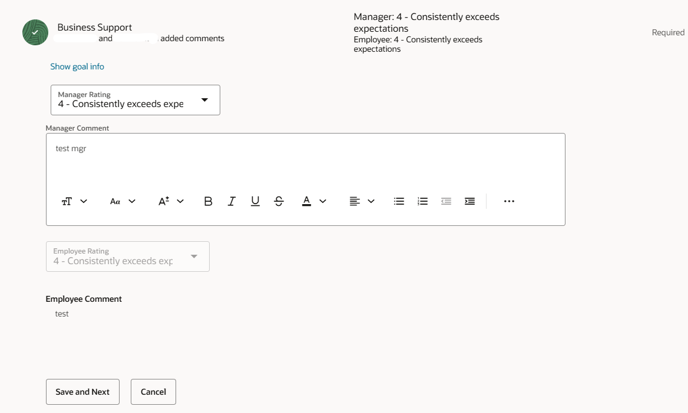
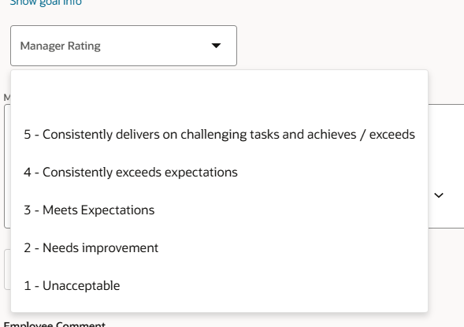
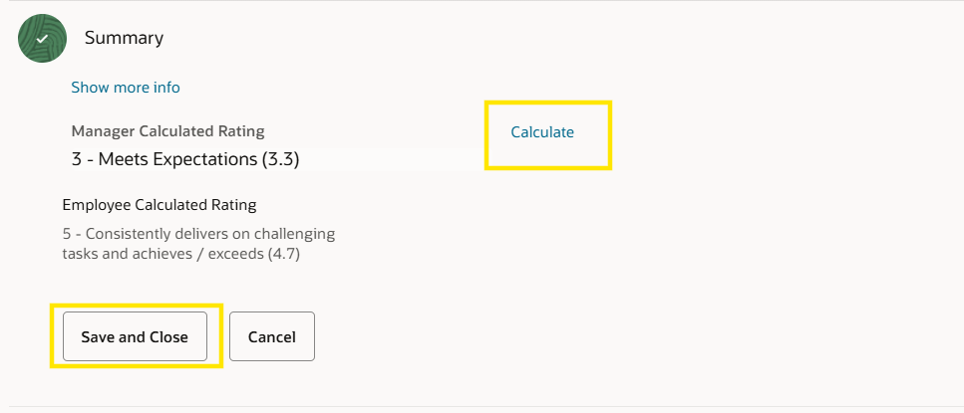
Go the goal section and give rating and comment for goal item and click ‘Save and Next’
Repeat the same process for each goal item.
In the goals summary section click on ‘Calculate’ to find calculated rating then give comments and click ‘Save and Close’.
Manager Evaluation – Performance Document

Slide 17
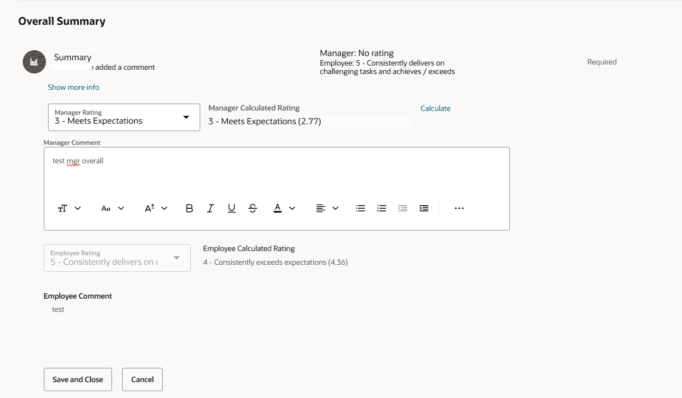
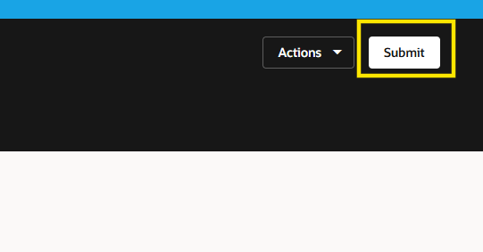
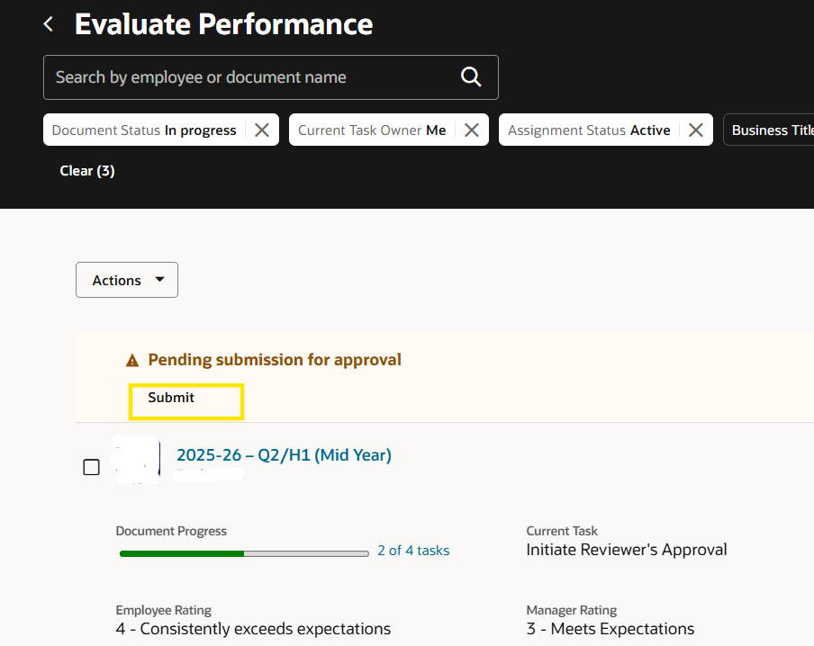
1.Scroll down to the ‘Overall Summary’ section and give overall rating and comment
2.After filling all the ratings and comments click on ‘Submit’
3.Again click on ‘Submit’ to submit the document for approval.
Manager Evaluation – Performance Document

Slide 18
Reviewer Related Tasks

Slide 19
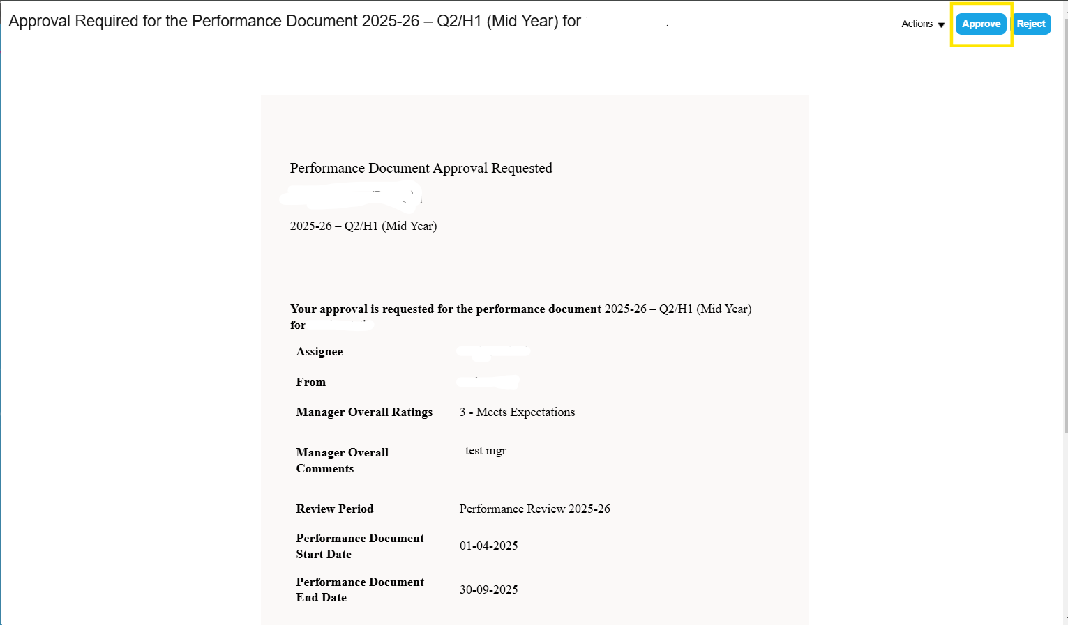
Approval by Reviewer
There are three ways to approve
1. Approving directly from the notification as shown below
2. By accessing the performance document from the notification (shown in the subsequent slides) and then approving the same
3. By accessing the performance document from My Team > Performance Overview and approving it
Reviewer Related Tasks

Slide 20
Approval by Reviewer
There are three ways to approve :
1. Approving directly from the notification as shown below
2. By accessing the performance document from the notification (shown in the subsequent slides) and then approving the same
3. By accessing the performance document from My Team > Performance Overview and approving it through :
My Team > Performance Overview
Steps to approve:
Select the review period
Locate the employee
Click on their name to open the document
Click ‘See details’
Then ‘Approve’ and finally ‘Submit’
Reviewer Related Tasks

Slide 21
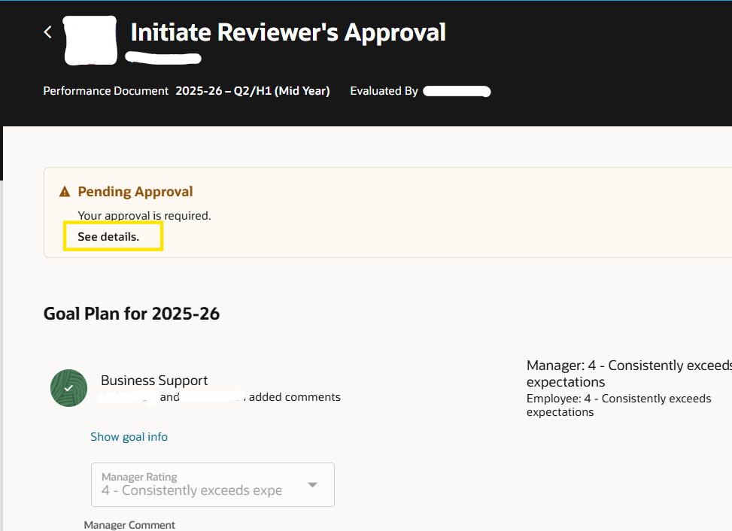
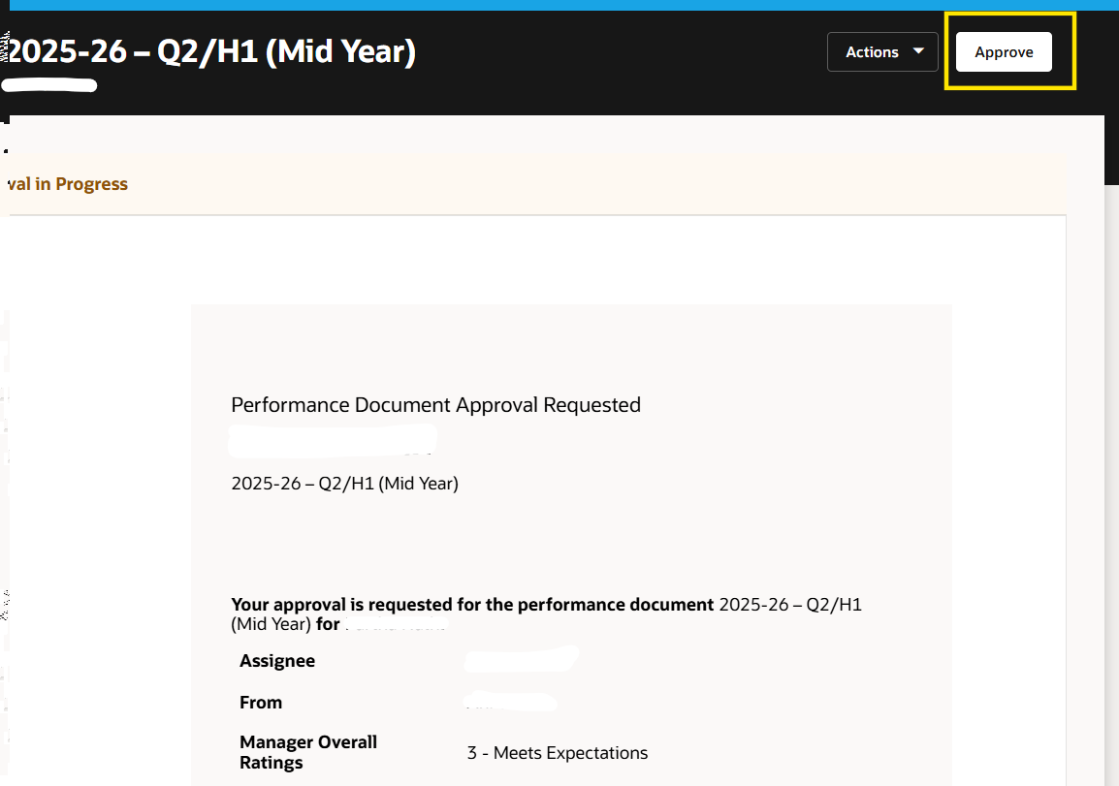
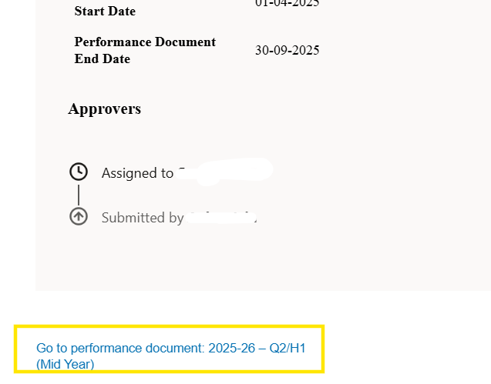
Accessing the performance document from the notification
Reviewer Related Tasks

Slide 22
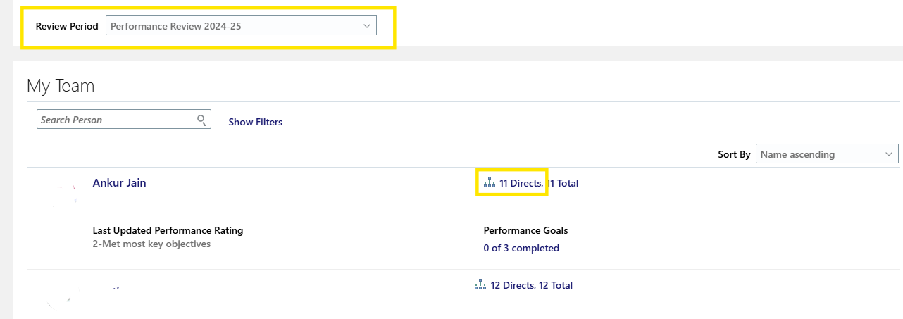
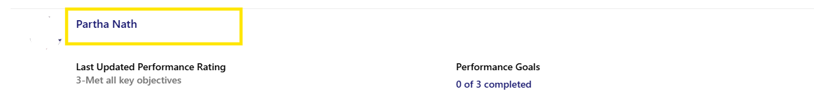
Go to My Team > Performance Overview select the review period
Click on the link highlighted in the below image right next to the employee for whom you want to list the indirect reports
Click on the employee name for whom you want to approve the document.
Reviewer Related Tasks
Line manager name
Employee Name

Slide 23
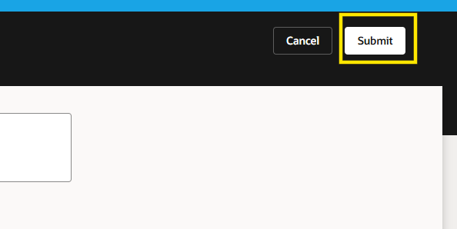
Navigate to the performance document for which your approval is pending and click ‘See details’
Then click on ‘Approve’ and then ‘Submit’
Reviewer Related Tasks

